Slide 1
RUNGTA COLLEGE OF DENTAL SCIENCES AND RESEARCH
SYPHILIS
DEPARTMENT OF GENERAL MEDICINE

Slide 2
SPECIFIC LEARNING OBJECTIVES
MUST KNOW | NICE TO KNOW | DESIRE TO KNOW
ETIOLOGY | DIFFERENTIAL DIAGNOSIS | LATE SYPHILIS
CLINICAL MANIFESTATIONS | LATENT SYPHILIS | CARDIOVASCULAR SYPHILIS
PRIMARY SYPHILIS |  | LATE BENIGN SYPHILIS
SECONDARY SYPHILIS

Slide 3
CONTENTS
INTRODUCTION
ETIOLOGY
CLINICAL MANIFESTATIONS
PRIMARY SYPHILIS
SECONDARY SYPHILIS
DIFFERENTIAL DIAGNOSIS
LATENT SYPHILIS
LATE SYPHILIS
CARDIOVASCULAR SYPHILIS
LATE BENIGN SYPHILIS
Summary

Slide 5
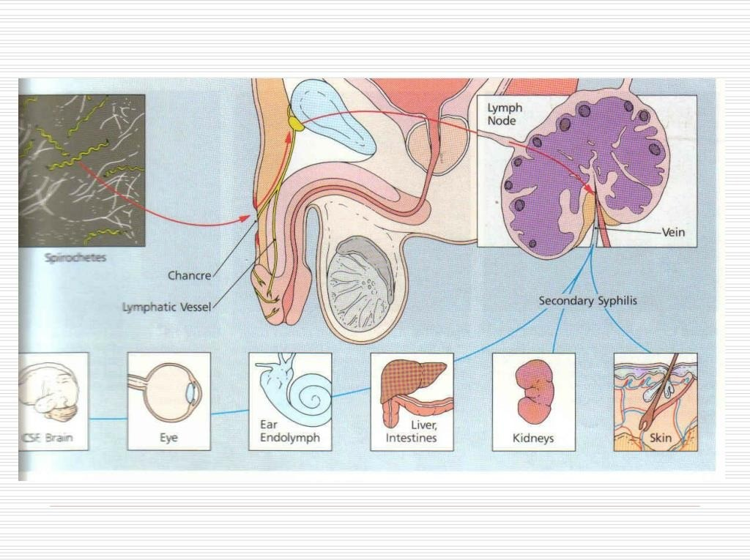

Slide 36
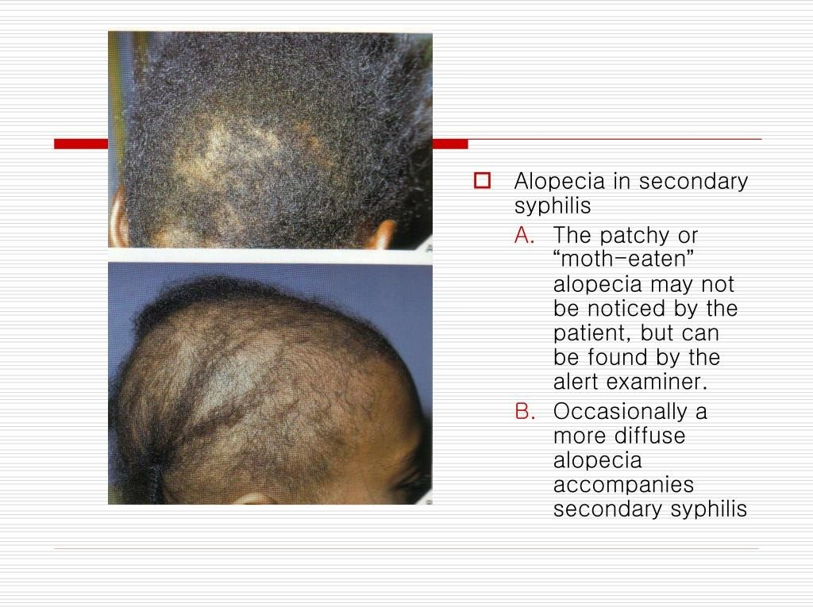

Slide 56
REFERENCES
DAVIDSON’S PRINCIPLES AND PRACTICE OF MEDICINE; 23rd edition
HARRISON’S PRINCIPLE OF INTERNAL MEDICINE; 21ST edition
TEXTBOOK OF CLINICAL MEDICINE by S.N Chugh ;5th edition

Slide 57
QUESTION AND ANSWERS

Slide 58
THANK YOU....

